Slide 1

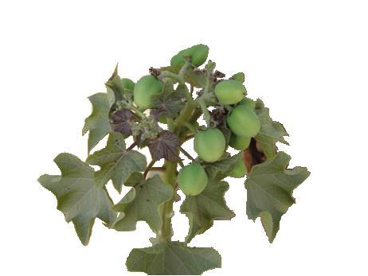
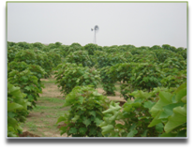
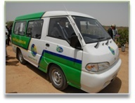
Pakistan State Oil
PAKISTAN ENERGY SCENARIO & PSO’S INITIATIVE
Presented by :
Syed Nawaid Anjum Zaidi
Deputy General Manager
NBD-Alternate Energy
Pakistan State Oil
17th February 2012

Slide 2
OUTLINE OF PRESENTATION
World Energy Scenario
Energy Scenario in Pakistan
Latest alternate fuels & their future in Pakistan

Slide 3
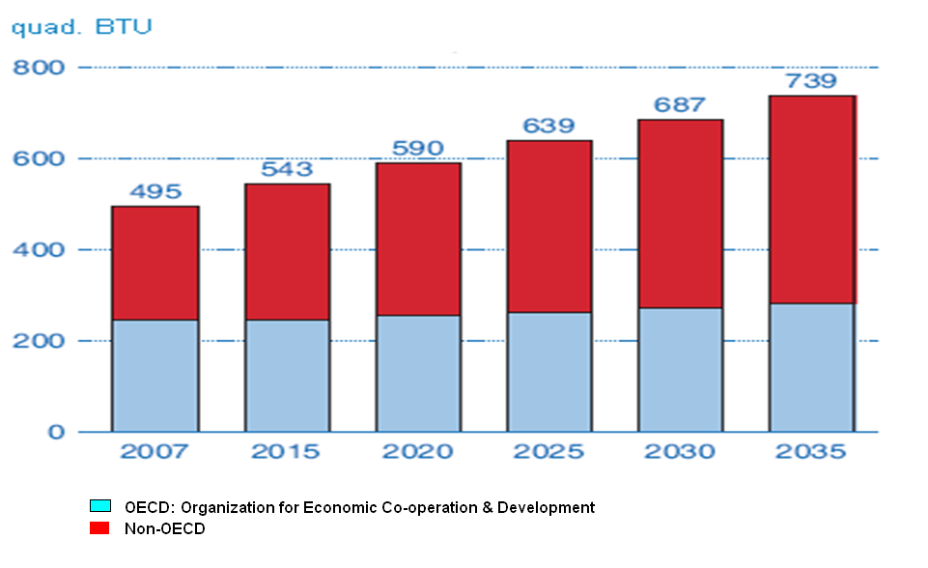
WORLD MARKETED ENERGY CONSUMPTION
Source: International Energy Outlook 2010
Notes:
World marketed energy consumption increases by 49 percent from 2007 to 2035
Total energy demand in non-OECD countries increases by 84 percent, compared with an increase of 14 percent in OECD countries.
Energy demand varies across regions and countries of the world, based on levels and mixes of economic activity and technological development, among other factors. Non-OECD economies account for about 95 percent of the world increase in industrial sector energy consumption. Rapid economic growth is projected for non-OECD countries, accompanied by rapid growth in their combined total energy consumption.

Slide 4
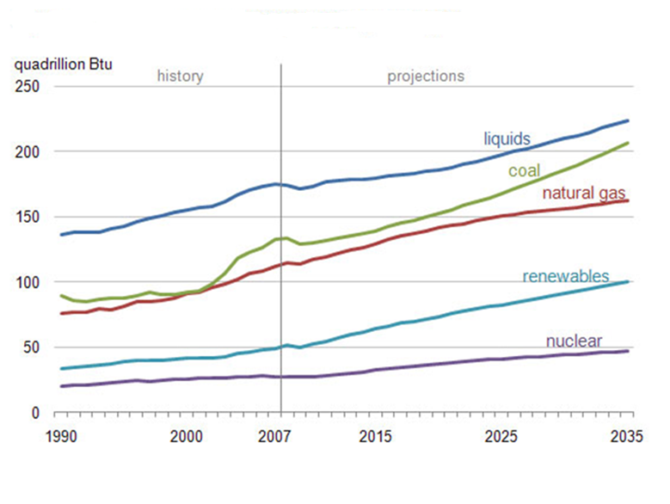
WORLD MARKETED ENERGY USE BY FUEL TYPE
Source: International Energy Outlook 2010
Notes:
This slide projects increased world consumption of marketed energy from all fuel sources over the 2007-2035 projection period.
Fossil fuels are expected to continue supplying much of the energy used worldwide. Although liquid fuels remain the largest source of energy, the liquids share of world marketed energy consumption falls from 35 percent in 2007 to 30 percent in 2035, as projected high world oil prices lead many energy users to switch away from liquid fuels when feasible.

Slide 5
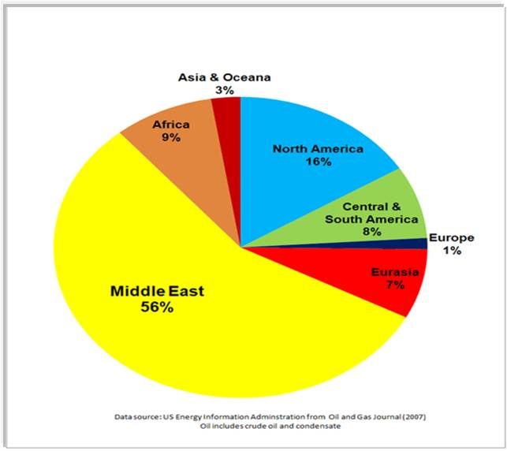
WORLD OIL RESERVES BY REGION
Notes:
At present much of the energy requirement is fulfilled by fossil fuel (oil). This is the situation of world oil reserves by region. Pakistan lies in the region having only 3% of the total world’s oil reserves.

Slide 6
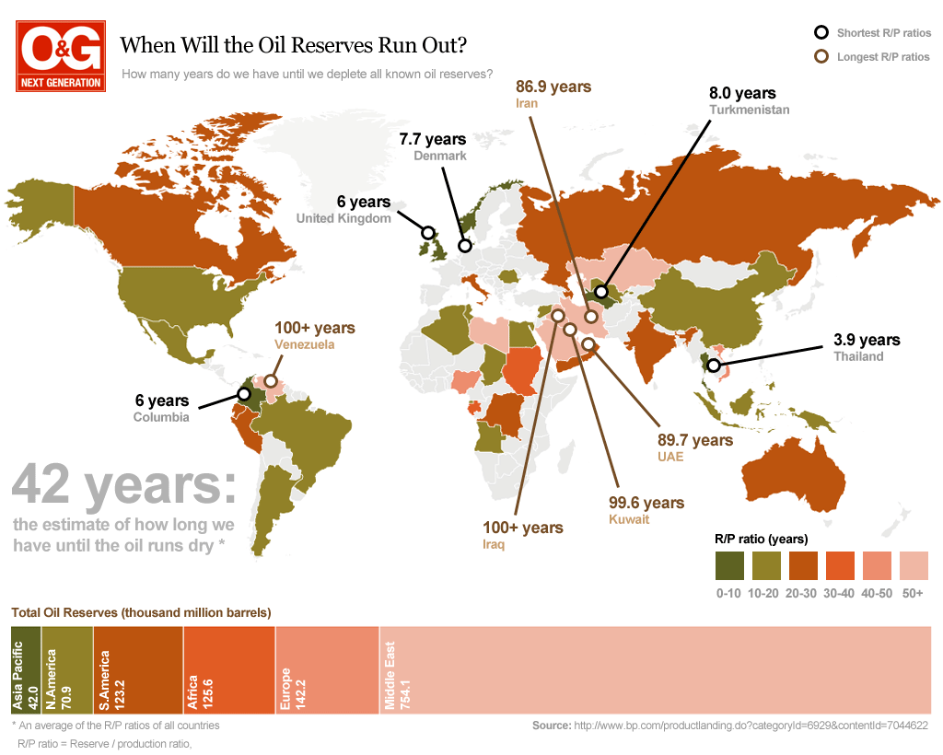

Slide 7
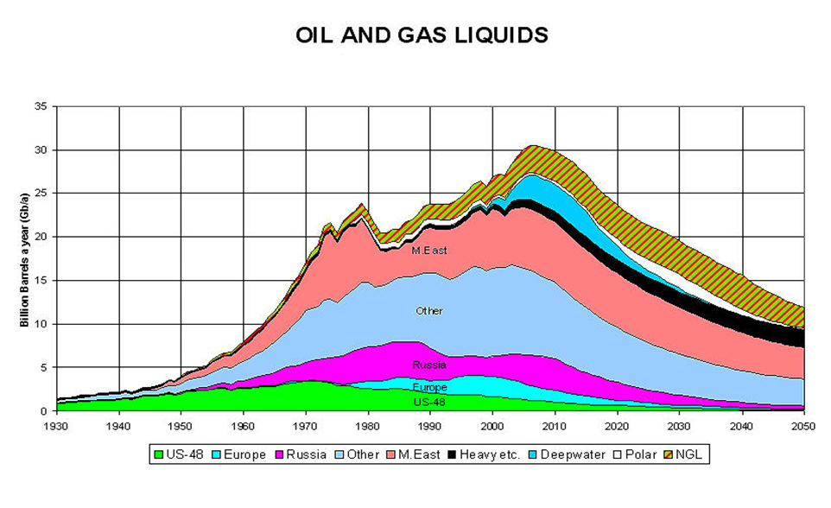
PEAK OIL
Notes:
The Oil Peak according to a recent prognosis of the Association for the Study of Peak Oil. Note that the US, Russian and European oil supplies have 'peaked' already years ago. After 2008, the global crisis kicks in.
The real problem, of course, is that our society is addicted to cheap, abundant oil. Our cars, airplanes and ships run on oil. Our electricity is generated in oil-fueled power plants. The stuff you buy in the stores is brought there by trucks that run on oil. In the end, literally everything is to some degree ‘made’ of oil!
So when oil gets expensive, so does our world. Even seemingly innocent things like socks, drinking water and bread will become very expensive. Factories and businesses will go bankrupt. Unemployment will explode, pushing up the state deficit and deepening the crisis even more. Banks will shut down, thereby killing the savings of their clients. In the end, the Oil Peak will send massive shockwaves through the world’s economies.
Now take a look at different scenarios:
What if demand of oil remains same & supply decreases?
What if supply remains same & demand increases?
When demand of oil is increased and its supply decreases?

Slide 8

Pakistan Energy Situation

Slide 9
POWER DEMAND AND SUPPLY POSITION
Year ( Year ending 30th June) | Firm Supply (MW) | Peak Demand (MW) | Surplus/Deficit (MW)
2008 | 15,055 | 17,689 | (2634)
2009 | 15,055 | 19,080 | (4025)
2010 | 15,055 | 20,584 | (5,529)
Electricity load shedding in the spring of 2011 reached more than 6,000 MW primarily due to fuel supply constraints.
              Planning Commission of Pakistan

Slide 10
PRIMARY ENERGY SUPPLIES BY SOURCE 2009-10
Source: Ministry of Petroleum & Natural Resources-HDIP

Slide 11
PETROLEUM PRODUCT CONSUMPTION BY SECTOR 2009-10
Total Consumption 19.13 Million Ton
Source: Ministry of Petroleum & Natural Resources-HDIP

Slide 12
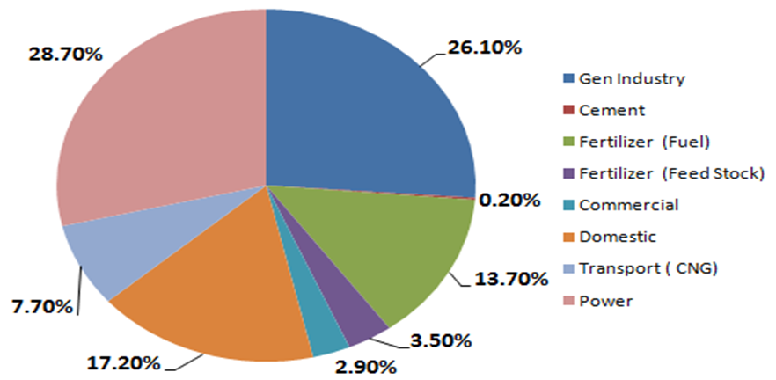
NATURAL GAS CONSUMPTION BY SECTOR 2009-10
30.8 MTOE
8.84MTOE
8.04MTOE
4.22 MTOE
Source: Ministry of Petroleum & Natural Resources-HDIP

Slide 13
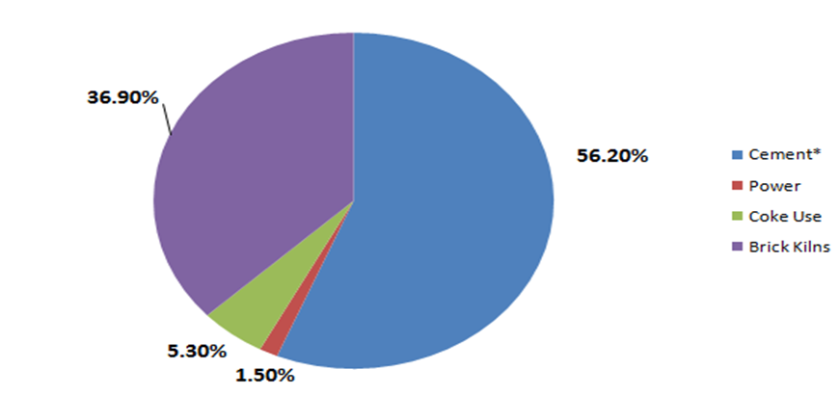
COAL CONSUMPTION BY SECTOR
2009-10
4.61 MTOE
1.70MTOE
2.6 MTOE
Source: Ministry of Petroleum & Natural Resources-HDIP

Slide 14
ENERGY MIX PROJECTIONS 2005-30
 | Current |  | Short Term |  | Medium Term |  |  |  | Long Term
 | 2004 |  | 2010 |  | 2015 |  | 2020 |  | 2025 |  | 2030
Total MTOE | 50.8 | % | 79.4 | % | 120.2 | % | 177.4 | % | 255.4 | % | 361.3 | %
Oil | 15.2 | 30 | 20.7 | 26 | 32.5 | 27 | 45.5 | 25.7 | 57.9 | 22.7 | 66.8 | 18.5
Natural Gas | 25.5 | 50 | 39.0 | 49 | 53.0 | 44 | 77.9 | 44 | 114.8 | 45 | 162.6 | 45
Coal | 3.3 | 6.5 | 7.2 | 9 | 14.5 | 12 | 24.8 | 14.0 | 38.3 | 15 | 68.65 | 19
Hydro | 6.4 | 12.7 | 11.0 | 13.9 | 16.4 | 13.6 | 21.4 | 12.1 | 30.5 | 12 | 38.9 | 10.8
Renewable | 0.0 | 0.0 | 0.84 | 1.1 | 1.6 | 1.3 | 3.0 | 1.7 | 5.58 | 2.2 | 9.2 | 2.5
Nuclear | 0.4 | 0.8 | 0.69 | 1.9 | 2.2 | 1.9 | 4.8 | 2.7 | 8.24 | 3.2 | 15.1 | 4.2
http://www.pc.gov.pk/vision2030/approach%20paper/Approach%20Paper.pdf

Slide 15
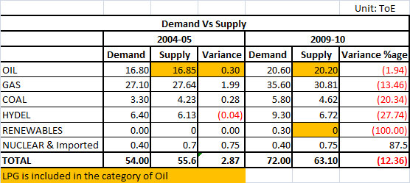

Slide 16
Energy crises has lead to tremendous opportunity for Alternate Energy Sources
Fossil fuel reserves are declining
Concerns over security of assured supplies
Ever-increasing prices of petroleum products
Environment effects

Slide 17
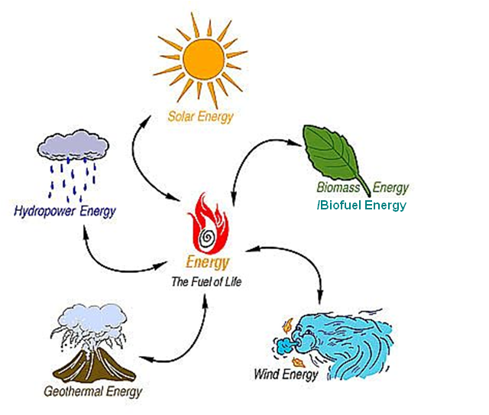
AVAILABLE ALTERNATIVE ENERGY SOURCES

Slide 18
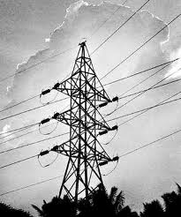
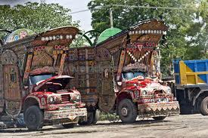
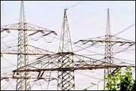
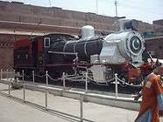
MAJOR ENERGY CONSUMERS
POWER SECTOR
TRANSPORT SECTOR

Slide 19
PETROLEUM PRODUCT CONSUMPTION IN TRANSPORT SECTOR 2009-10
8.86 MILLION TOE
Source: Ministry of Petroleum & Natural Resources-HDIP

Slide 20

Can Consumption of THIS HSD be fulfilled indigenously??

Slide 21
TYPES OF BIOFUEL
    Bioalcohols
    Biodiesel
    Vegetable oil
    Biogas
    Solid biofuels
Notes:
Bioalcohols: Biologically produced alcohols; most common is Ethanol; Alcohol fuels are produced by fermentation of sugars derived from wheat, corn, sugar beats, sugar cane, molasses and any sugar or starch that alcoholic beverages can be made from (like potato and fruit waste, etc.).
Biodiesel: It is produced from oils or fats using transesterification and is a liquid similar in composition to fossil/mineral diesel. Chemically, it consists mostly of fatty acid methyl (or ethyl) esters (FAMEs).
Vegetable Oil: Used vegetable oil is increasingly being processed into biodiesel, or (more rarely) cleaned of water and particulates and used as a fuel.
Biogas: Biogas is methane produced by the process of anaerobic digestion of organic material by anaerobic organism.
Solid biofuel includes wood, saw dust, grass cuttings, agricultural waste, charcoal, dried manure etc.

Slide 22

BIODIESEL POTENTIAL IN PAKISTAN
Biodiesel is a clean-burning alternative to petroleum diesel made from domestic, renewable resources such as vegetable oils, recycled cooking oil and animal fats.

Slide 23
BIODIESEL
Biodiesel is a renewable, environmentally
friendly substitute for petro-diesel fuel.
It is produced from edible & non-edible oils, and animal fats.
Normally Biodiesel blends can be used in diesel engines without any alteration.

Slide 24
BENEFITS OF BIODIESEL
Economic
Saving of precious Foreign Exchange.
Poverty alleviation by providing jobs,
Create additional revenue for farmers
National Security
Reduces Dependence on Imported Oil
Sustainable, Renewable Resource grown domestically

Slide 25
BENEFITS OF BIODIESEL
Environmental
  Approx. 80% less carbon dioxide emissions
  Almost 100% less sulphur dioxide
  Over 90% reduction in total unburned hydrocarbons
  Approx. 75-90% reduction in aromatic hydrocarbons
  Significant reduction in particulates & carbon monoxide

Slide 26
SOURCES OF BIODIESEL
EDIBLE OIL SOURCES
  Sunflower
  Soybean (USA)
  Corn
  Rapeseed
  Others
NON-EDIBLE OIL SOURCES
  Pongamia (Sukh Chein)
  Jojoba
  Castor
  Jatropha
  Others

Slide 27

PSO’s Journey to Bio-Diesel
VISION
‘To excel in delivering values to the customer as an innovative and dynamic energy company that gets to the future first.’

Slide 28
FOCUS OF PSO
Non-edible plant seeds as feed stock
Avoidance of competition with Food Crops
Utilization of country’s ample Marginal /Barren land
Conserving agricultural Water Resources.
Produce biodiesel at minimum possible cost

Slide 29
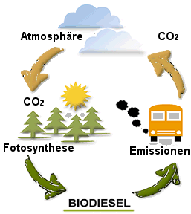
OBJECTIVE
PSO’s ultimate goal is to significantly participate in blending 10% of Country’s total petro-diesel consumption (8 million tonnes) with biodiesel; in line with GoP’s directives

Slide 30
GoP’s DIRECTIVES
ECC’s Decision of 15th Feb, 2008:
5% biodiesel blending with petro-diesel by 2015
10% biodiesel blending with petro-diesel by 2025

Slide 31
GoP / ECC’s INCENTIVES
All imported plant, machinery, equipment and raw material for use in production of biodiesel shall be exempted from
        Custom duty
        Income tax
        Sales Tax
        S.R.O. 474 (I)/2008 dated 21.05.2008

Slide 32
SCOPE FOR BIODIESEL
Total consumption of diesel per year: 8 M tons
10% of requirement (Biodiesel) per year: 800 K tons
Land requirement (800 shrubs / acre): 812500 Acres
Yield varies from 4 - 8 kg/shrub

Slide 33
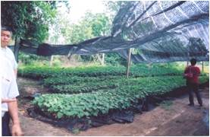
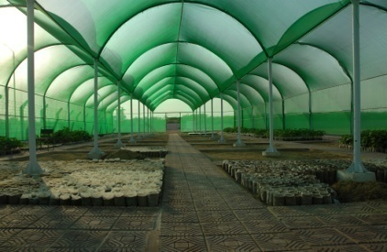
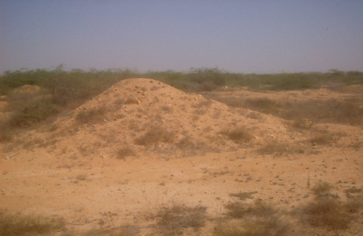
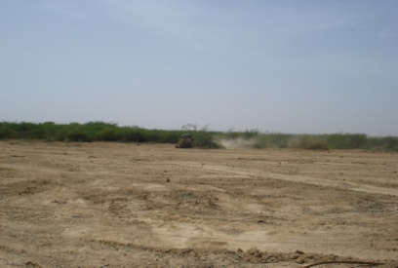
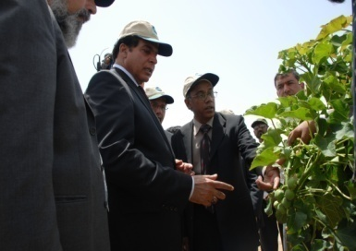
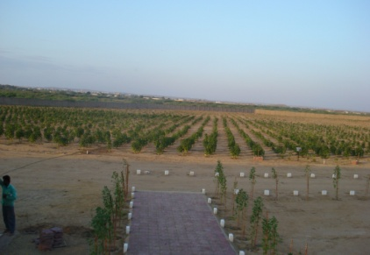
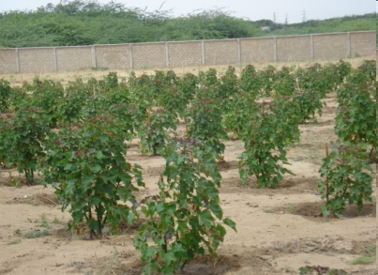
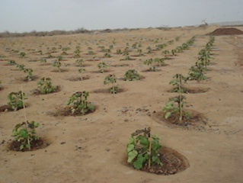
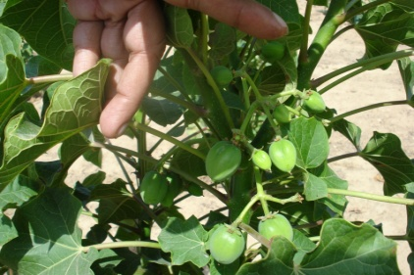
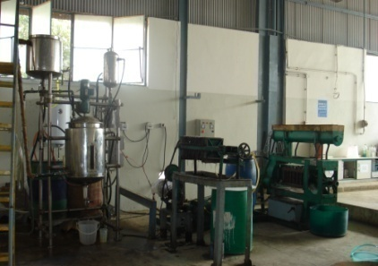
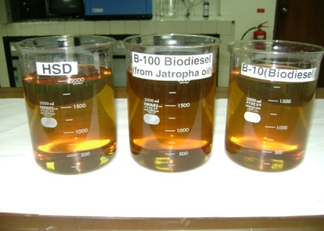
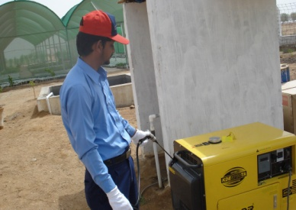
PICTORIAL VIEW OF PSO’s JOURNEY TO BIODIESEL
Visits
Nursery
Selection of land
Land Preparation
Site Visit
Plantation overview
5 month old Plant
Jatropha Plantation
Fruiting
Transesterification unit
B-100,HSD & B-10
Testing of B-10

Slide 34
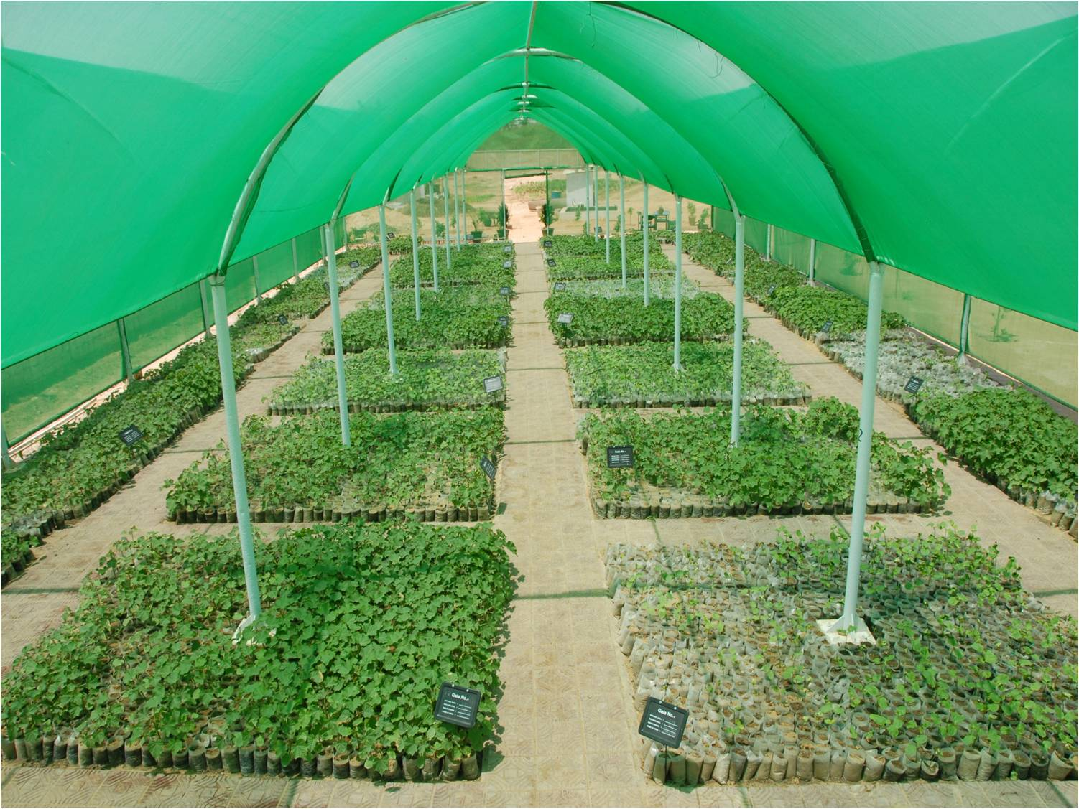
Set up the nurseries
Notes:
This is the PSO Jatropha Nursery which was developed to produce saplings of Jatropha for plantation. Initially we used seeds imported from Thailand, China & India. At present, we are using our own seeds for Jatropha multiplication.

Slide 35
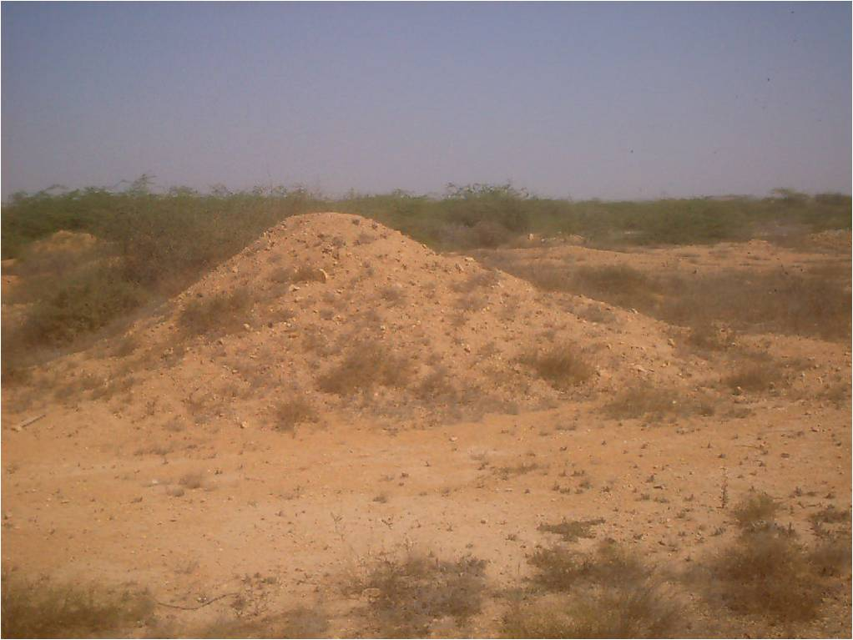
Selection of land
Barren/marginal land selected for Jatropha at PMY-Karachi
Notes:
This was the condition of the unutilized land on which we have developed our model farm.

Slide 36
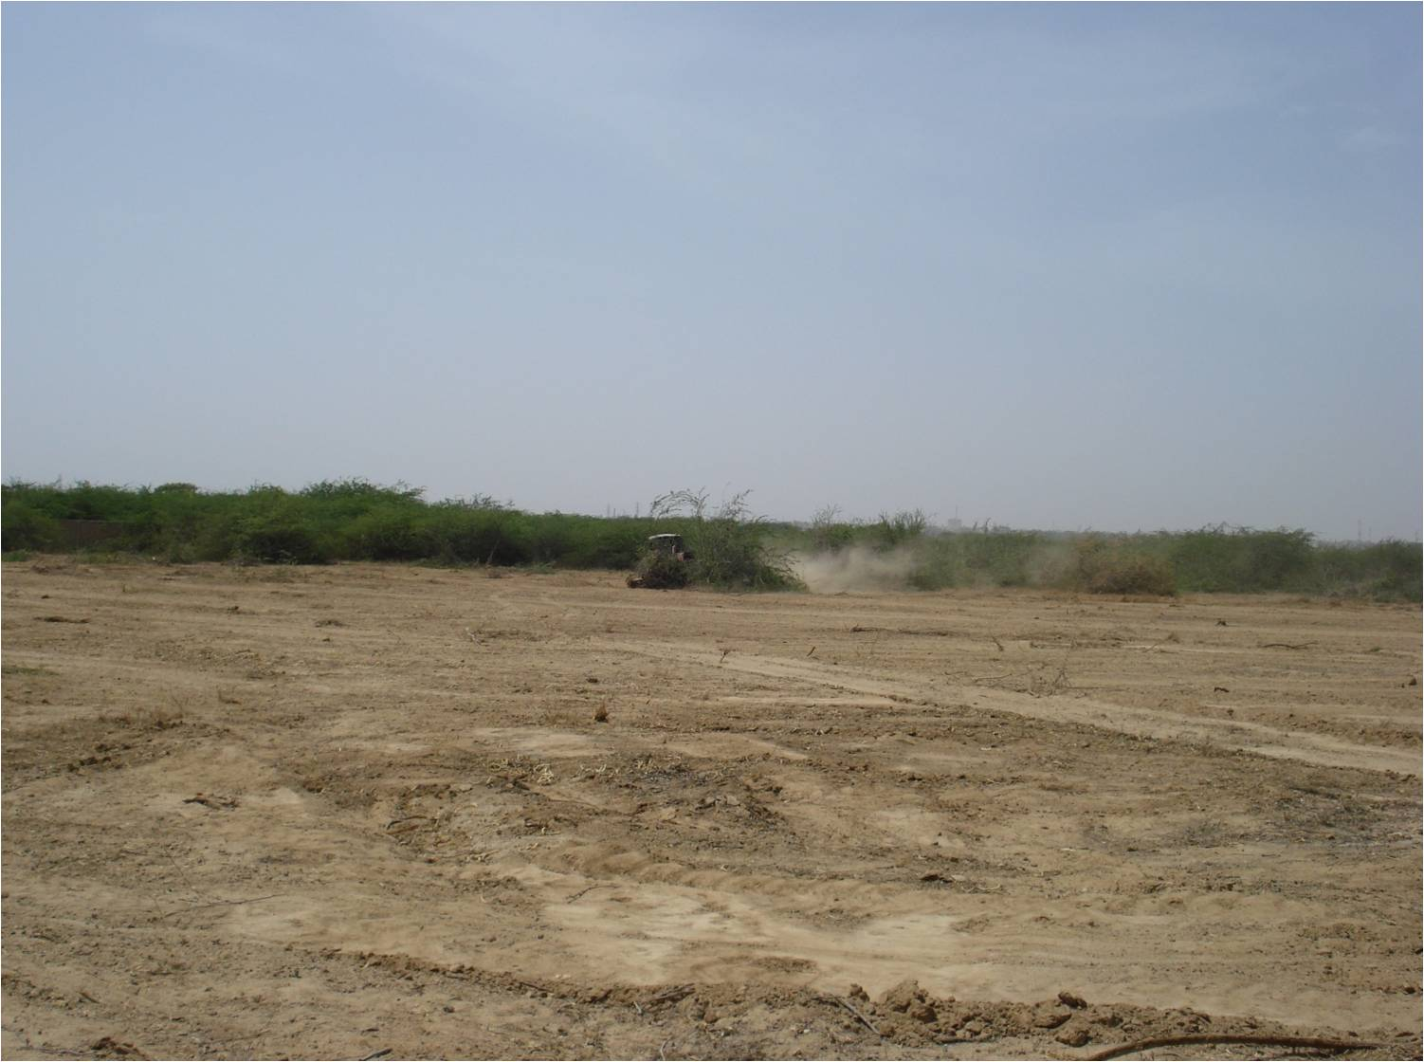
Land Preparation
Leveling & Dressing of Ground at Karachi in Progress
Notes:
Extensive land development activity was carried out to remove wild growth and level out the available land.

Slide 37
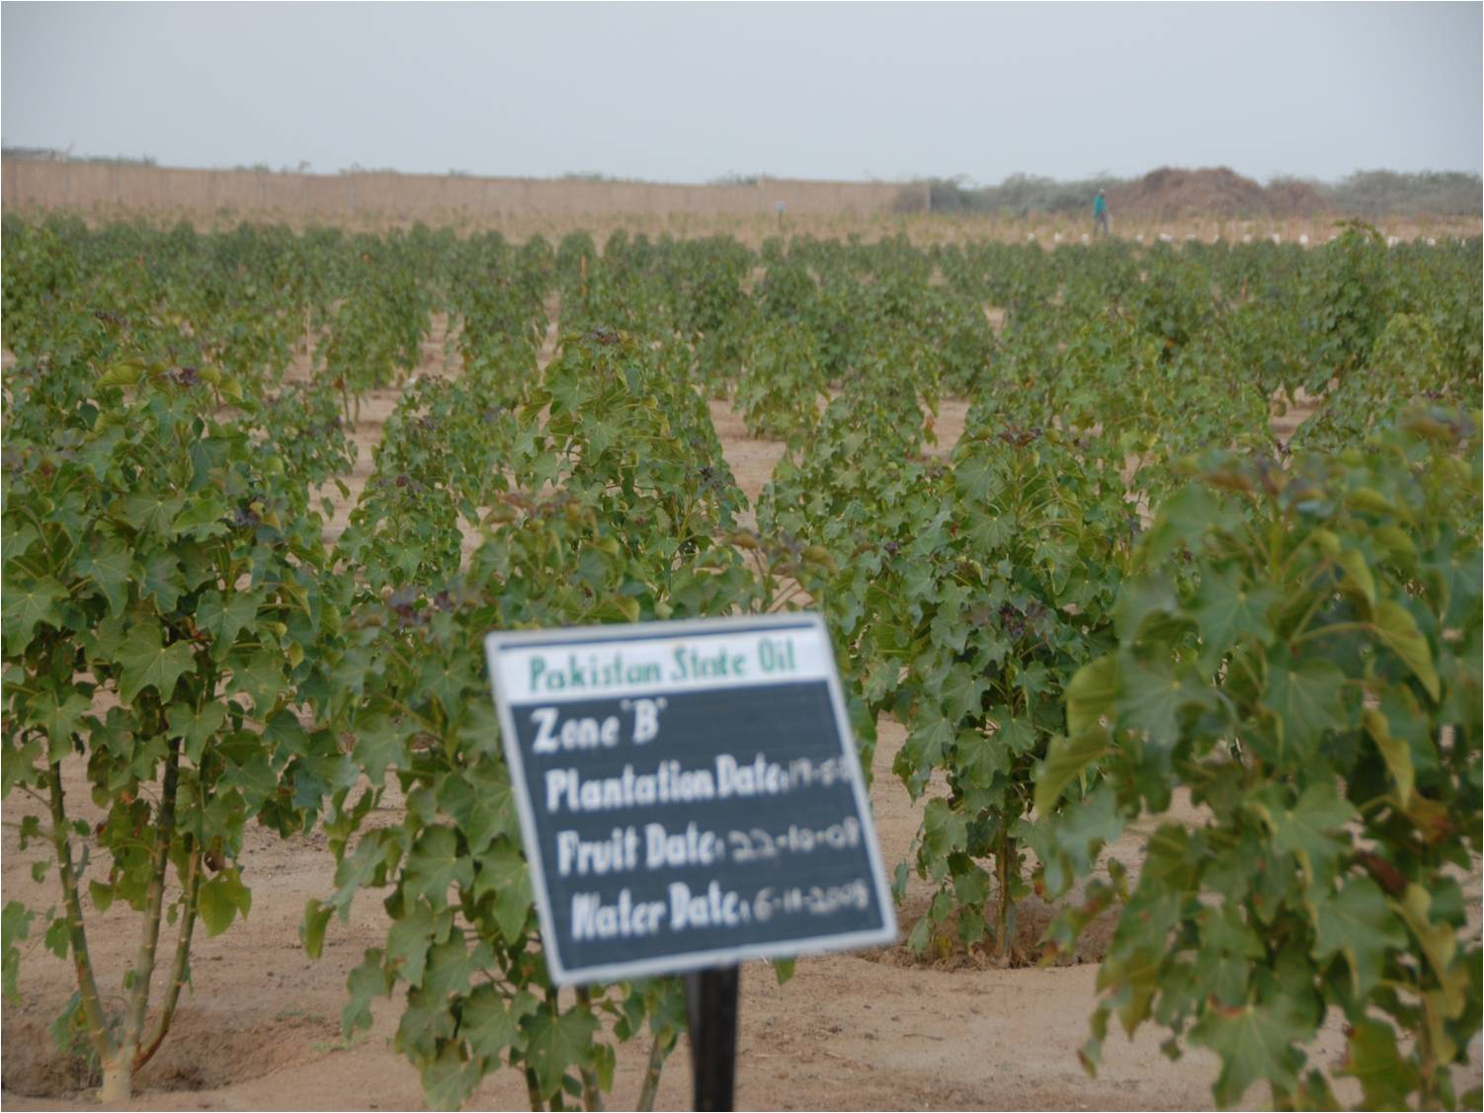
Jatropha Plantation
Notes:
The area has been divided into zones to facilitate research in respect of seed variety and type of irrigation method.

Slide 38
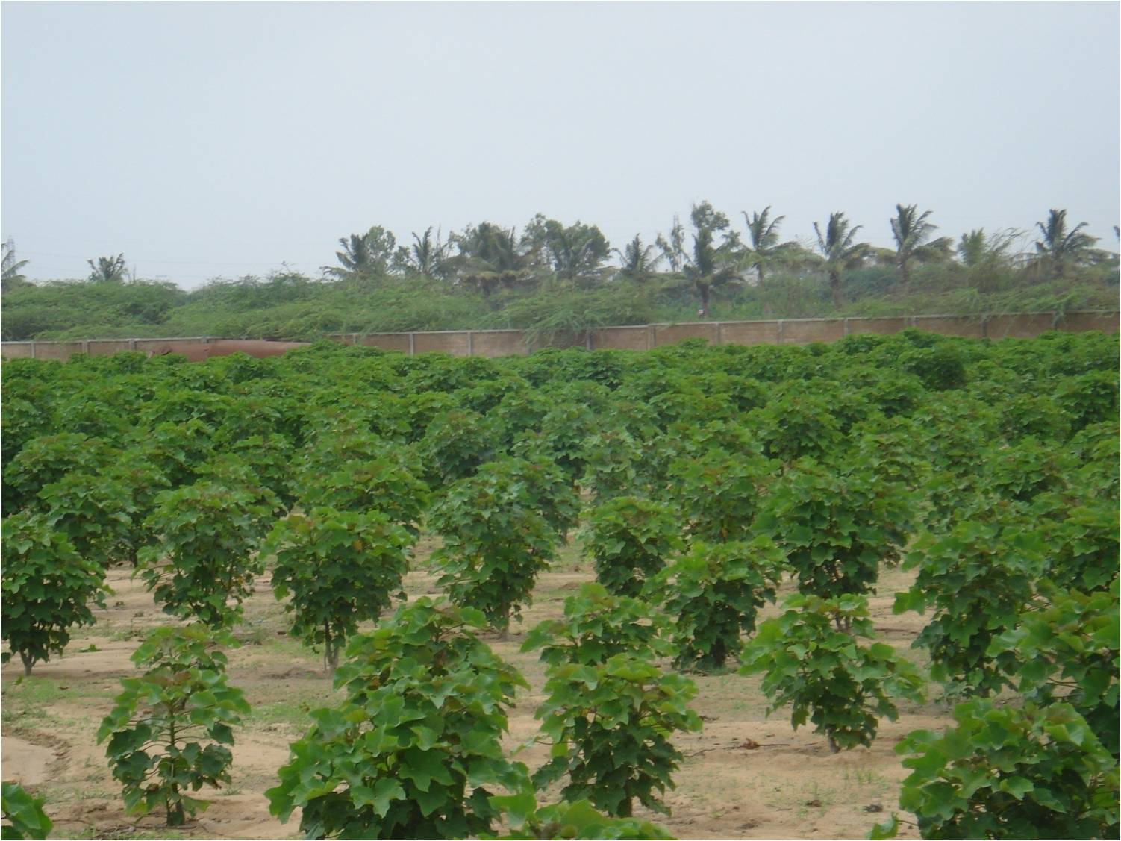
Jatropha Plantation

Slide 39
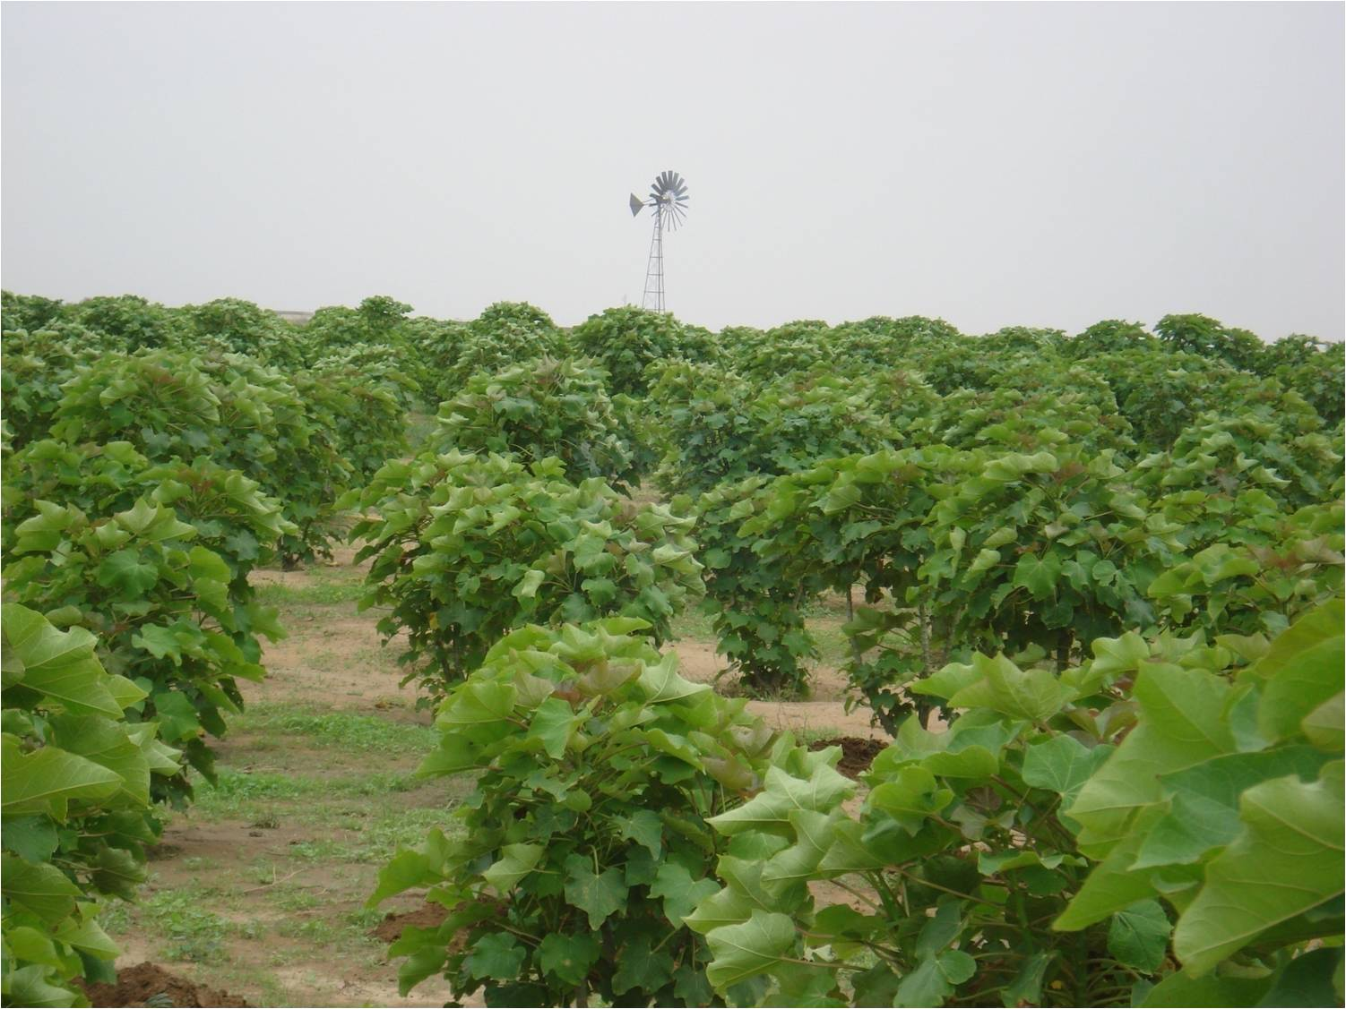
Jatropha Plantation

Slide 40
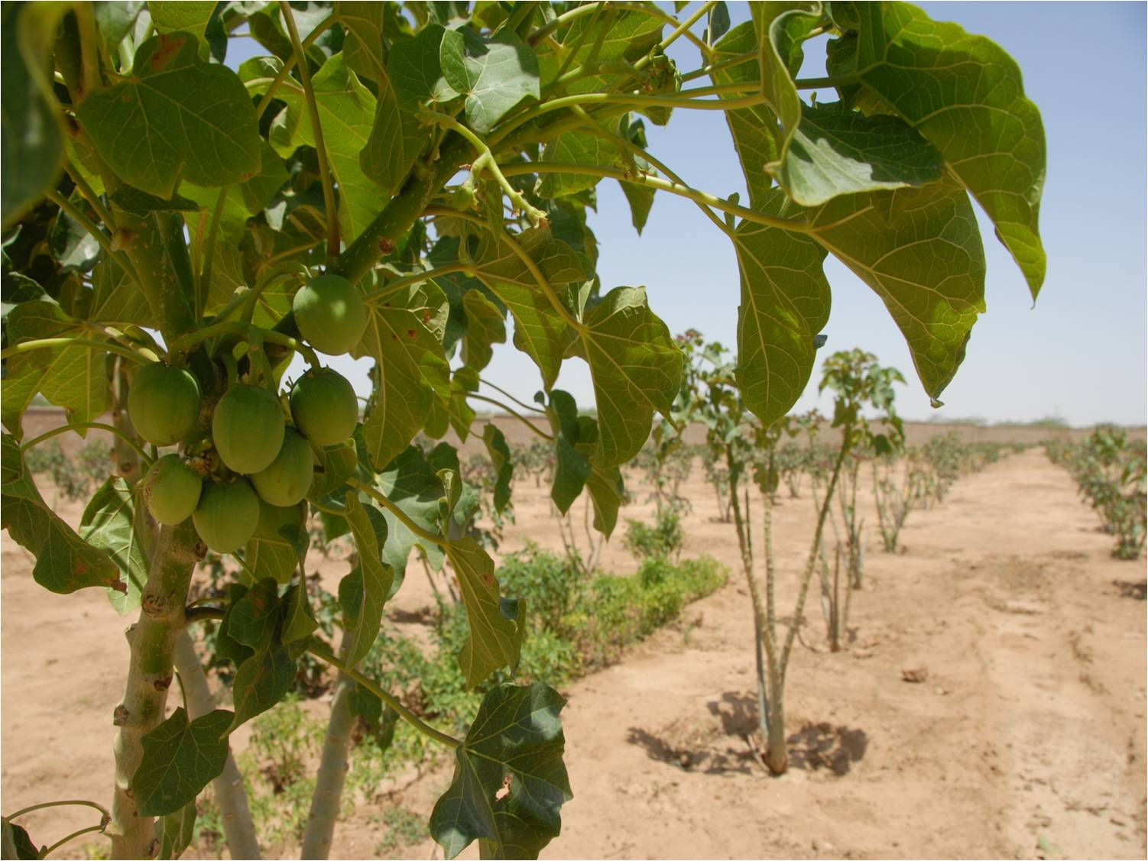
Jatropha Plantation
Notes:
The Jatropha plantation was started initially from 5 Acres and then gradually increased to about 22 acres at PMY.

Slide 41
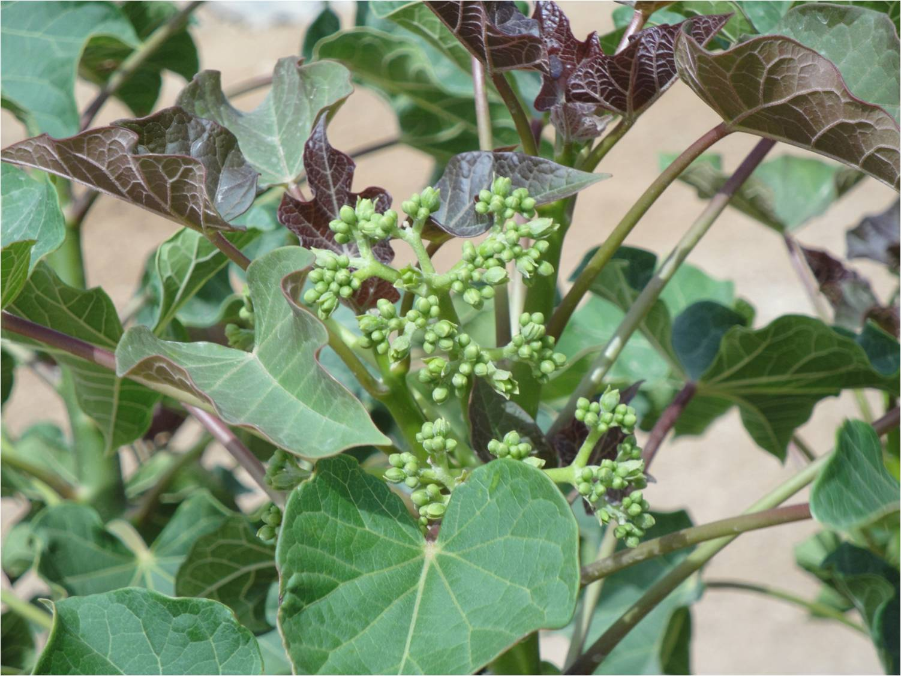
Jatropha Plantation

Slide 42
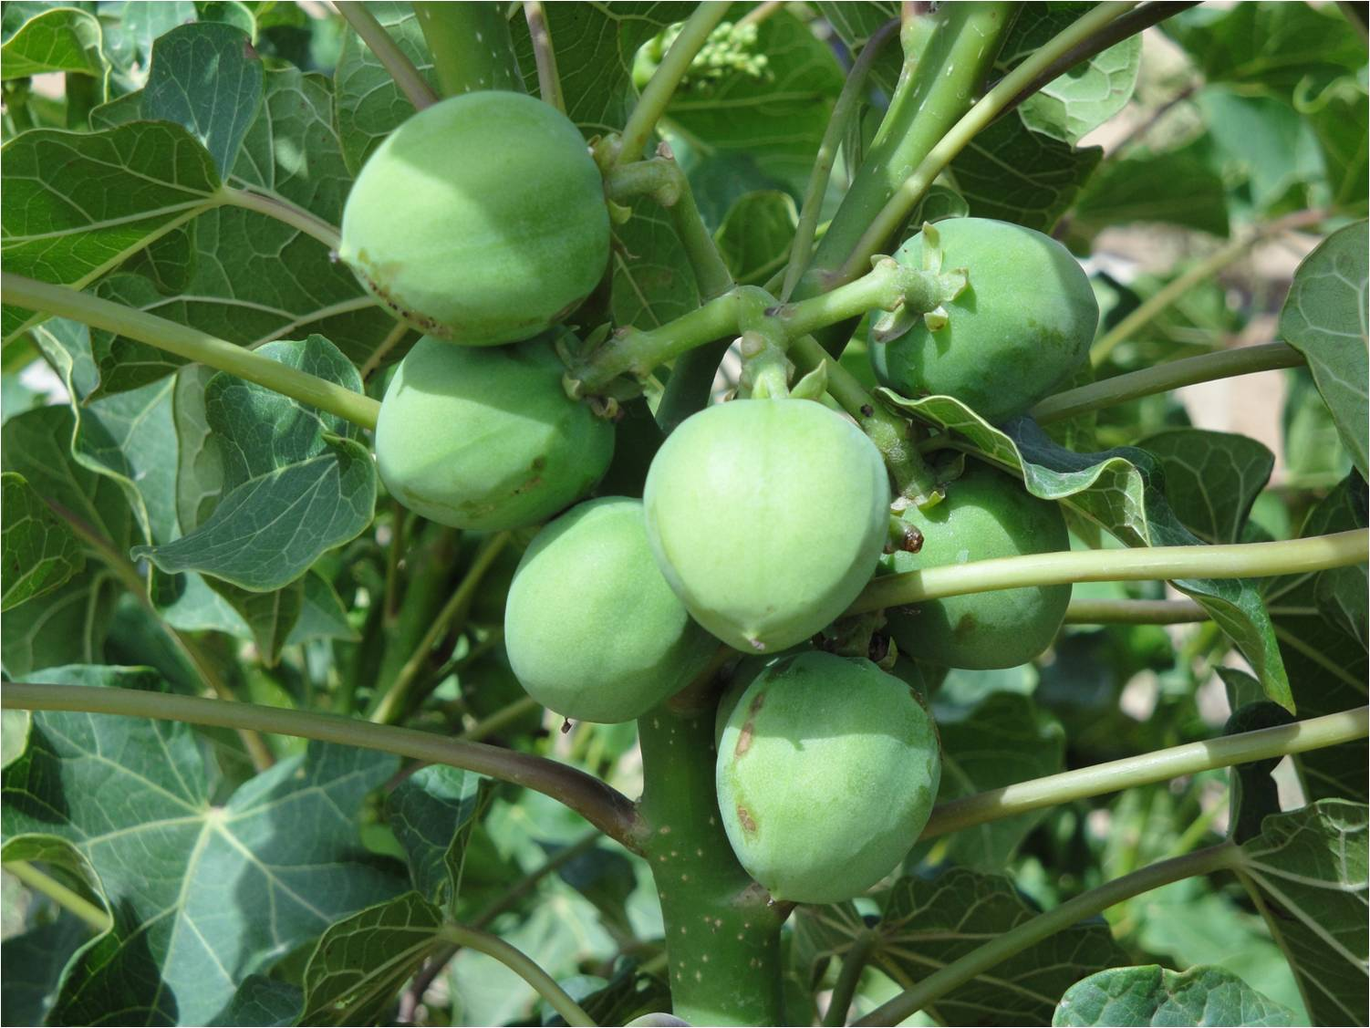
Jatropha Plantation
Observations & comments :
The progress of plants at PMY highlights high growth potential of Jatropha in Pakistani soil and climate conditions.
Flowering and fruiting on limited plants are found round the year.
Diseases like mealy bug and root rot; for which Profenofos and Fungicide are used to encounter them.

Slide 43

Site Visit
Site Visit of MoW&P Mr. Raja Parvez dated 20.04.2009
Notes:
43

Slide 44
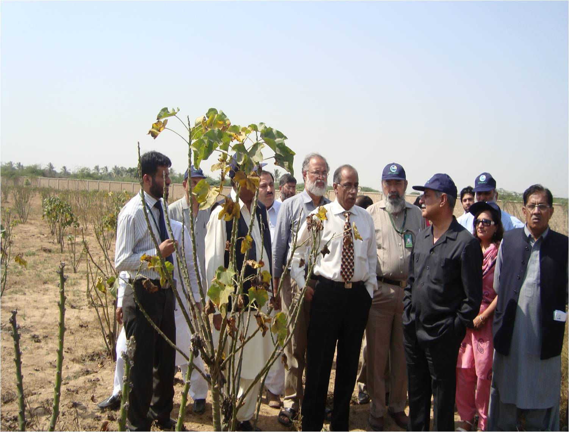
Site Visit
Site Visit of Fed. & Prov. ministers dated 20.10.2009

Slide 45
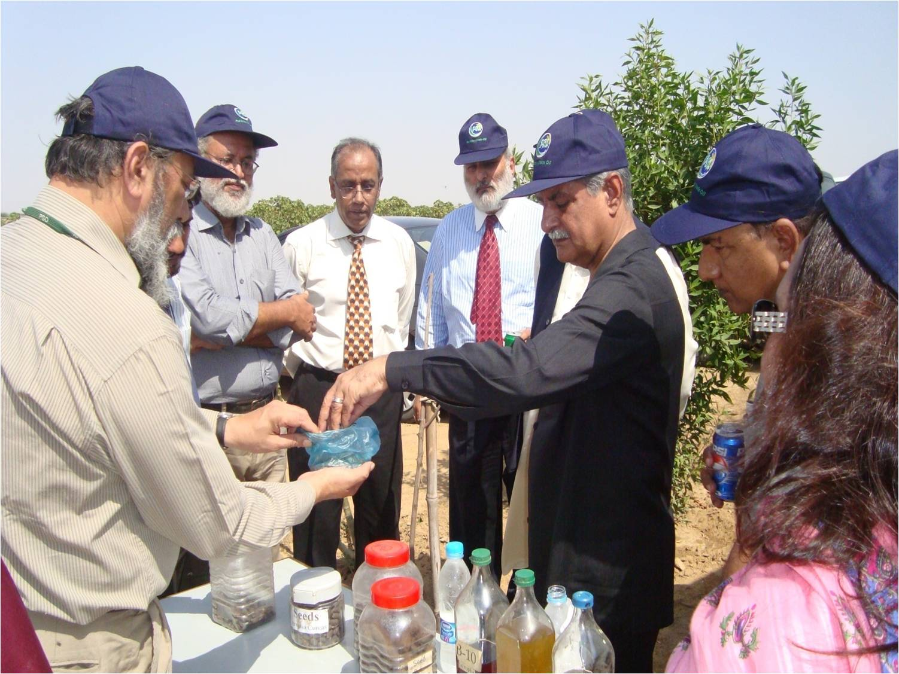
Site Visit
Site Visit of Fed. & Prov. ministers dated 20.10.2009

Slide 46
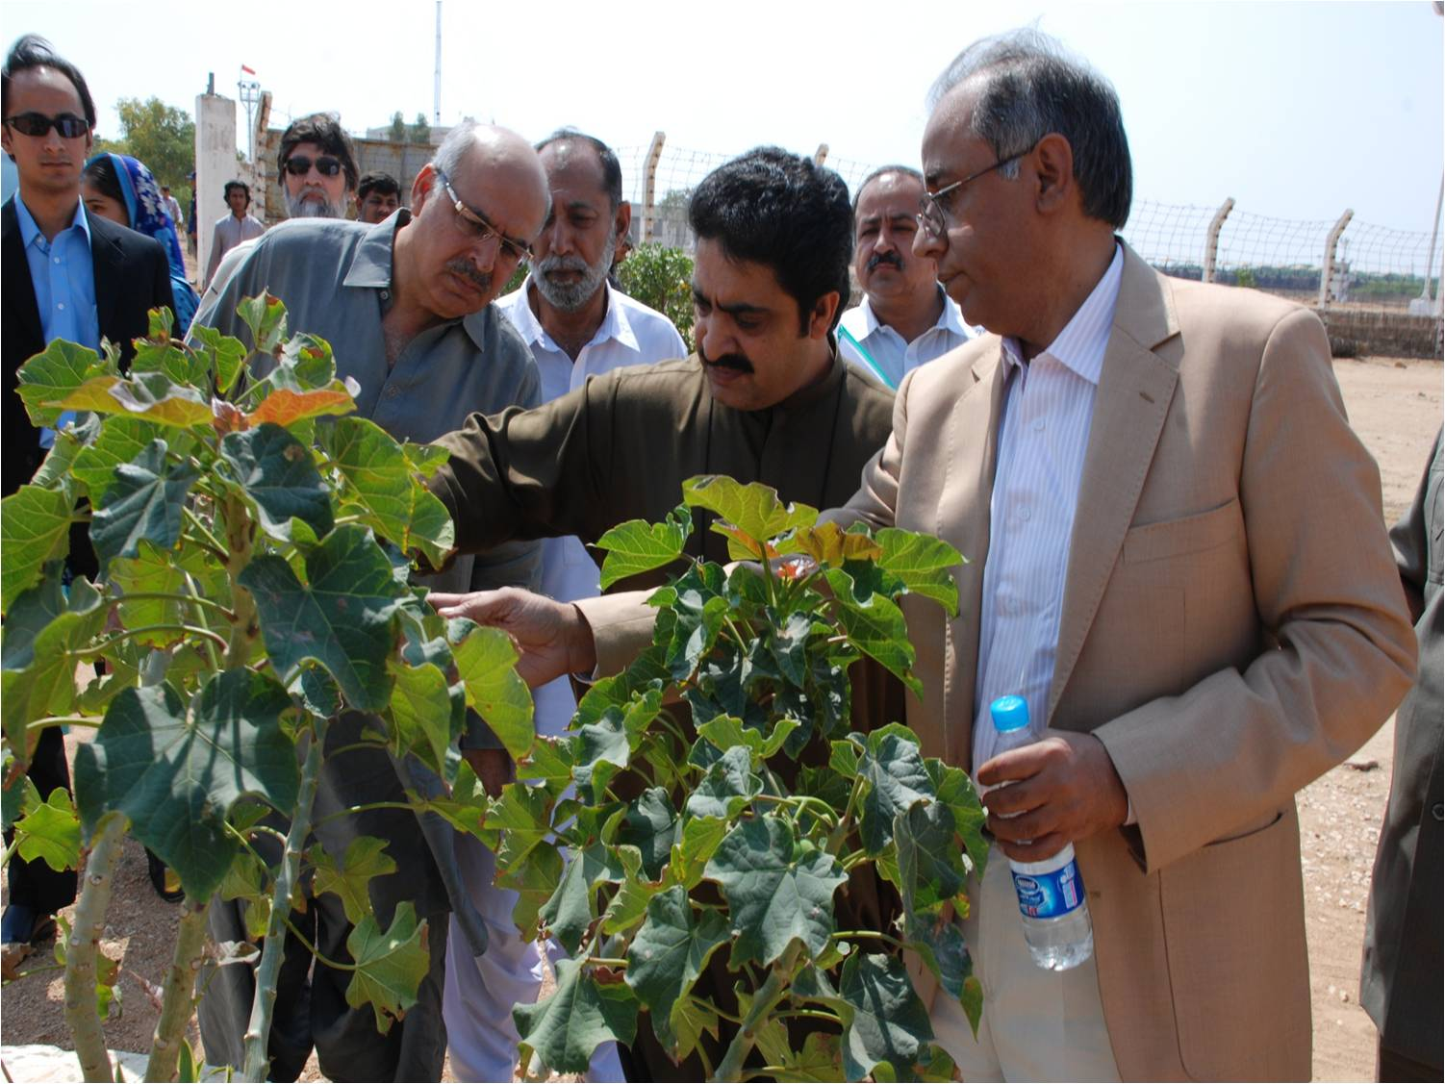
Site Visit
Site Visit of Fed. Minister of Food & Agriculture dated 05.03.2011

Slide 47

Transesterification
Obtaining Jatropha Oil & Biodiesel
(3)
Oil Expeller
Oil filter
(1)
(2)
Notes:
This is the setup of Transesterification plant acquired through the courtesy of AEDB and installed at our Kemari Installation. Through this plant we have so far produced about 1500 Liters of Bio Diesel for various tests and analysis.

Slide 48

HSD,B-100 & B-10

Slide 49
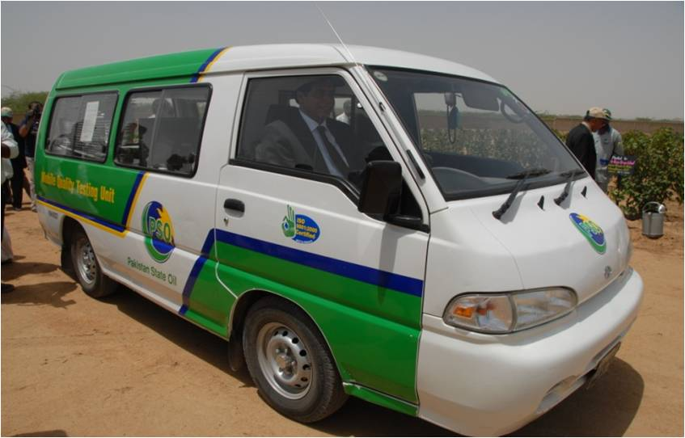
On Road Trial of Blended Biodiesel

Slide 50

On Road Trial of Blended Biodiesel

Slide 51
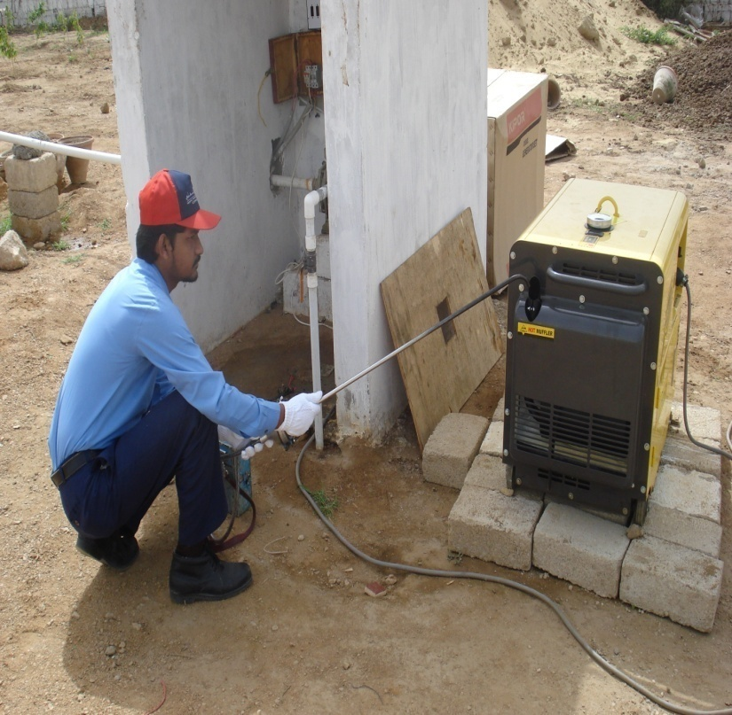
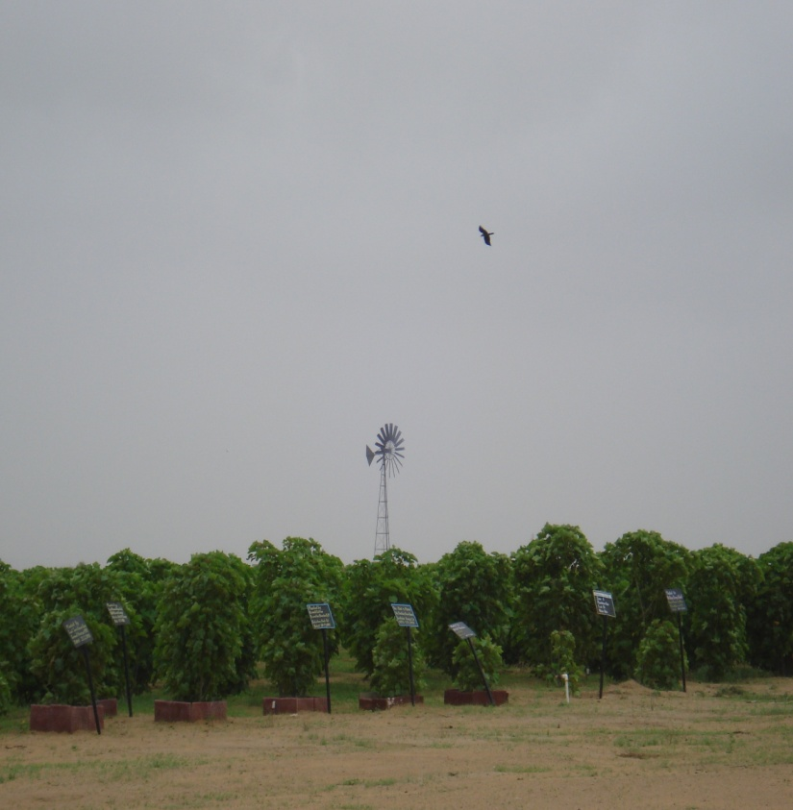
Demonstration of renewable sources at Site
DG set is running on blended Biodiesel
Windmill- Utilizing wind energy for pumping water

Slide 52
THANK YOU

Slide 53
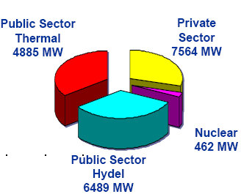
POWER SECTOR - TOTAL INSTALLED CAPACITY
Public Sector Thermal 5885 MW
Private Sector
7564 MW
PUBLIC SECTOR
 | MW | %
WAPDA | 12,374 | 59
NUCLEAR | 462 | 2
SUB TOTAL | 12,836 | 61
PRIVATE SECTOR
IPPs | 6,408 | 30
KESC | 1,756 | 9
SUB TOTAL | 7,564 | 39
GRAND TOTAL | 21,000 | 100
Public Sector
Hydel 6489 MW
Nuclear
462 MW

Slide 54
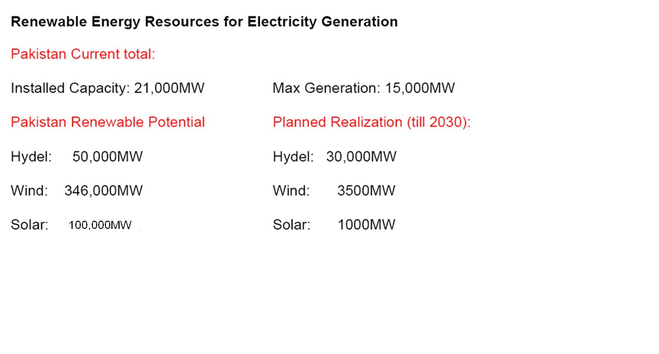
PAKISTAN’S RENEWABLE ENERGY POTENTIAL

Slide 55

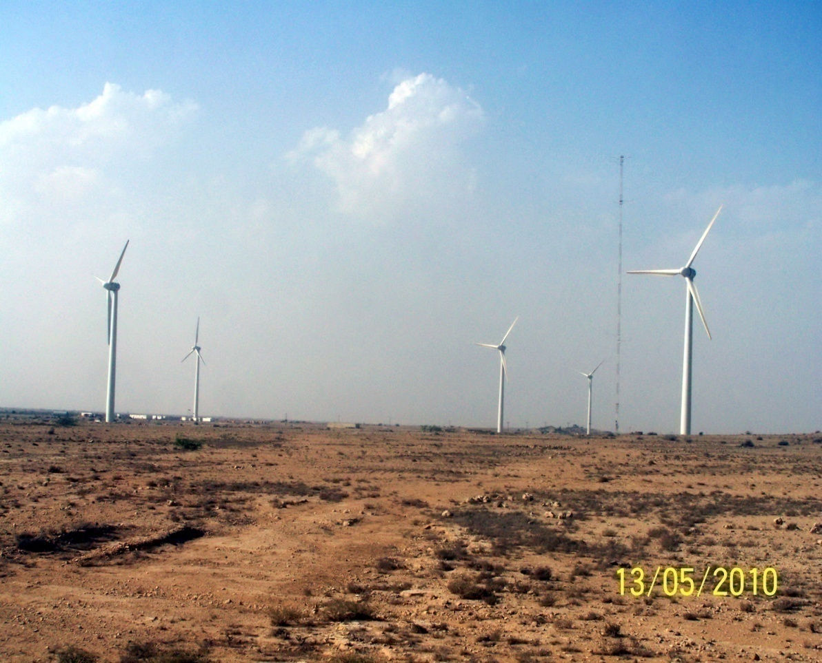
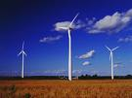
WIND ENERGY IN PAKISTAN
The wind map developed by National Renewable Energy Laboratory (NREL), USA in collaboration with USAID, has indicated a potential of 346,000 MW in Pakistan.

Slide 56



SOLAR ENERGY IN PAKISTAN
All Pakistan, especially Balochistan, Sind and Southern Punjab, receives abundant Solar radiation about 3000 hours / year (8 hrs/day). This is on the highest side of global averages. Exploitable potential of Solar energy at country level is of the order of 100,000 MW.

Slide 57
BIOMASS/WASTE POTENTIAL IN PAKISTAN
Bio-mass has a huge potential (over 2000 MW)
• Sugar industry has a potential of at least 700 MW additional power using Bagasse during sugar season
• Every major city has an estimated potential of 500 MW

Slide 58

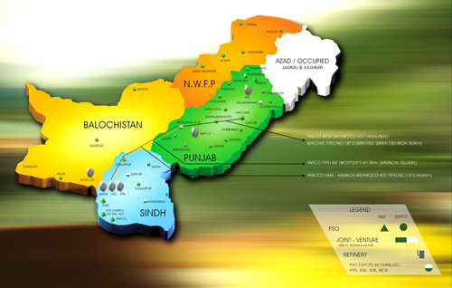
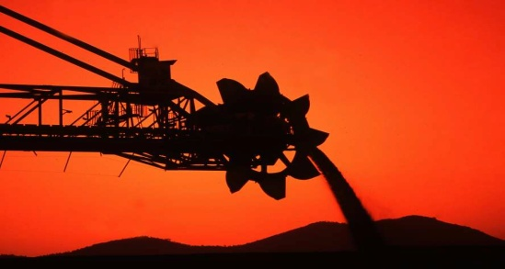



COAL AVAILABILITY IN PAKISTAN
Reserves in Pakistan
Sind | 185,457 million tonnes
Punjab | 235 million tonnes
Baluchistan | 217 million tonnes
KPK | 90 million tonnes
Azad Kashmir | 9 million tonnes
Thar

Slide 59


